Slide 1
Birds of the Wetland Practice #1
Naturesongs.com
And introduced Species

Slide 2
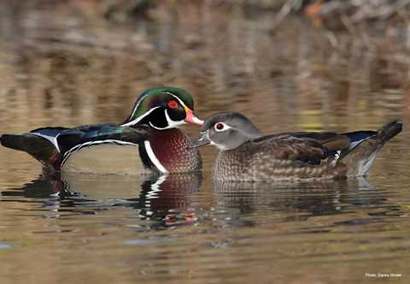


Slide 3
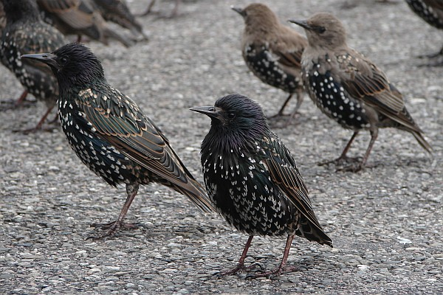
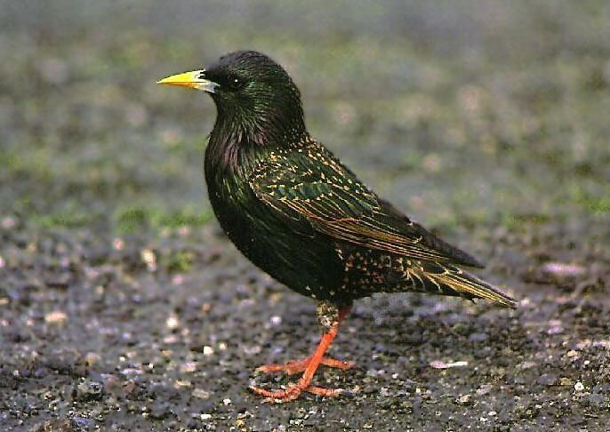

Slide 4
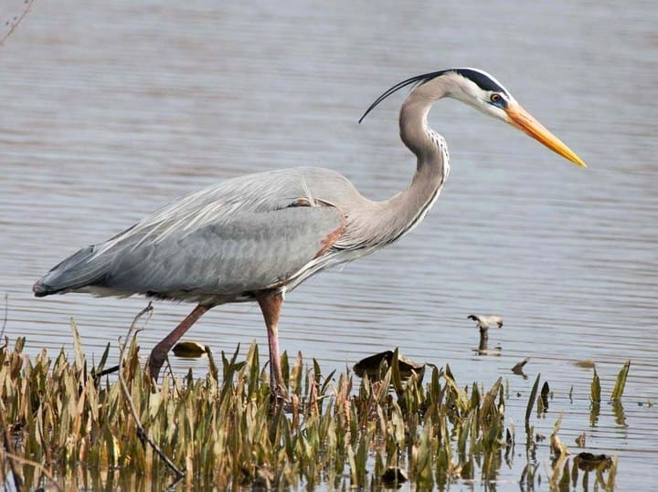

Slide 5
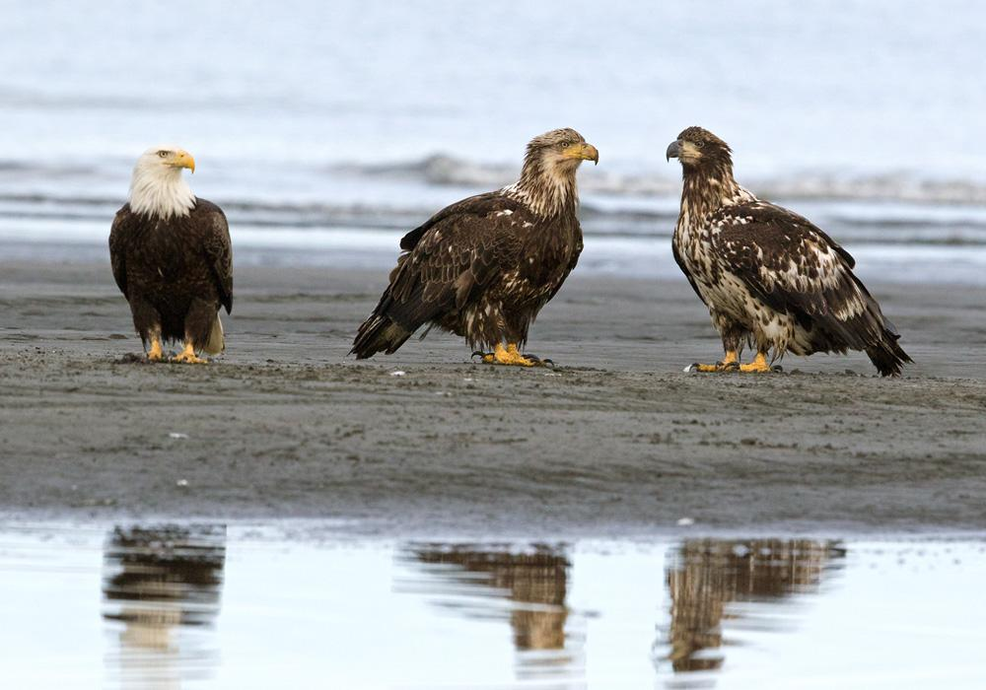
http://soundbible.com/981-Bald-Eagle.html#Bald%20Eagle%20Sound

Slide 6
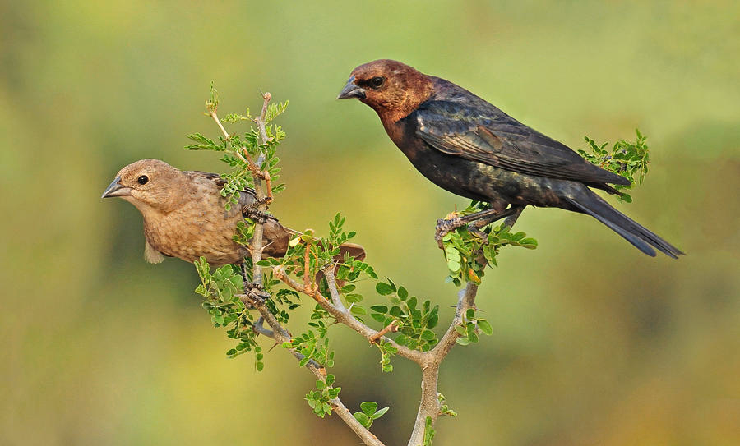

Slide 7
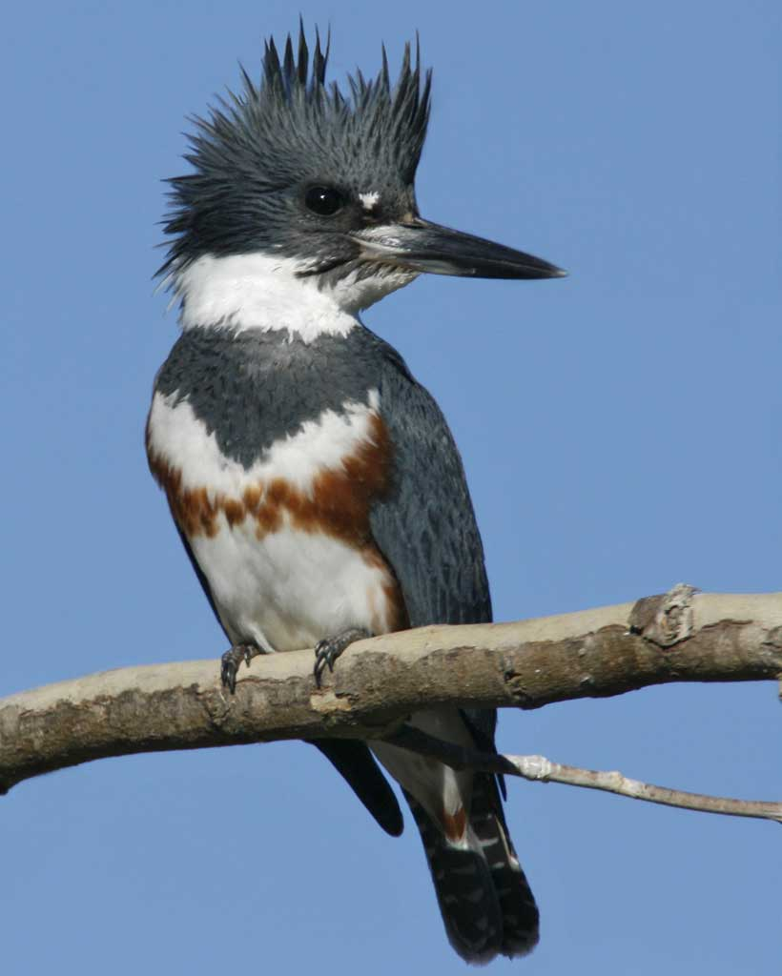
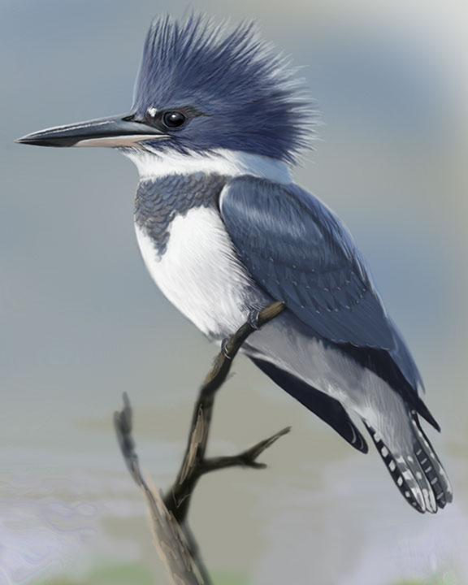

Slide 8
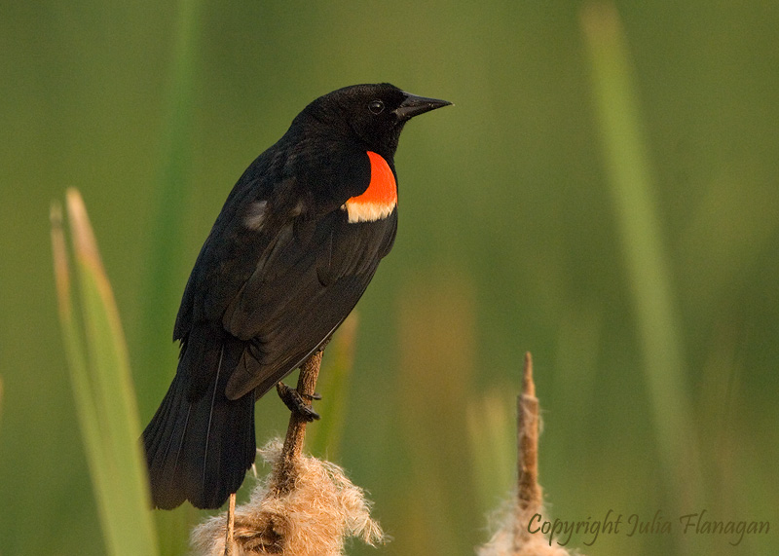
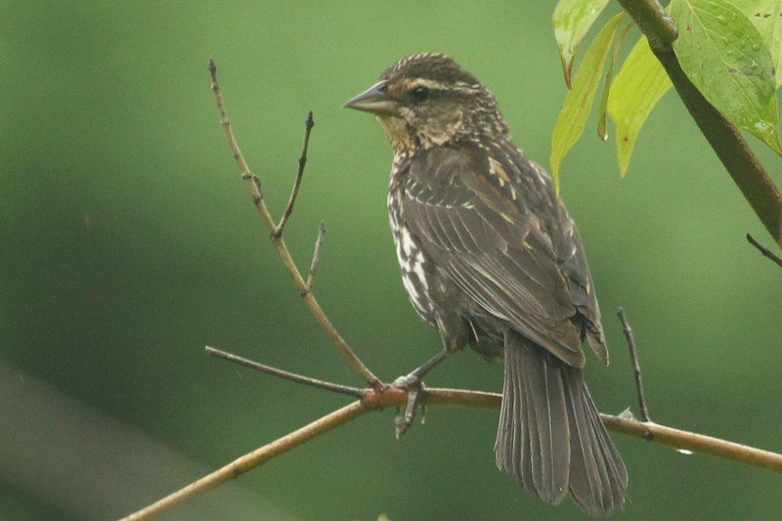

Slide 9
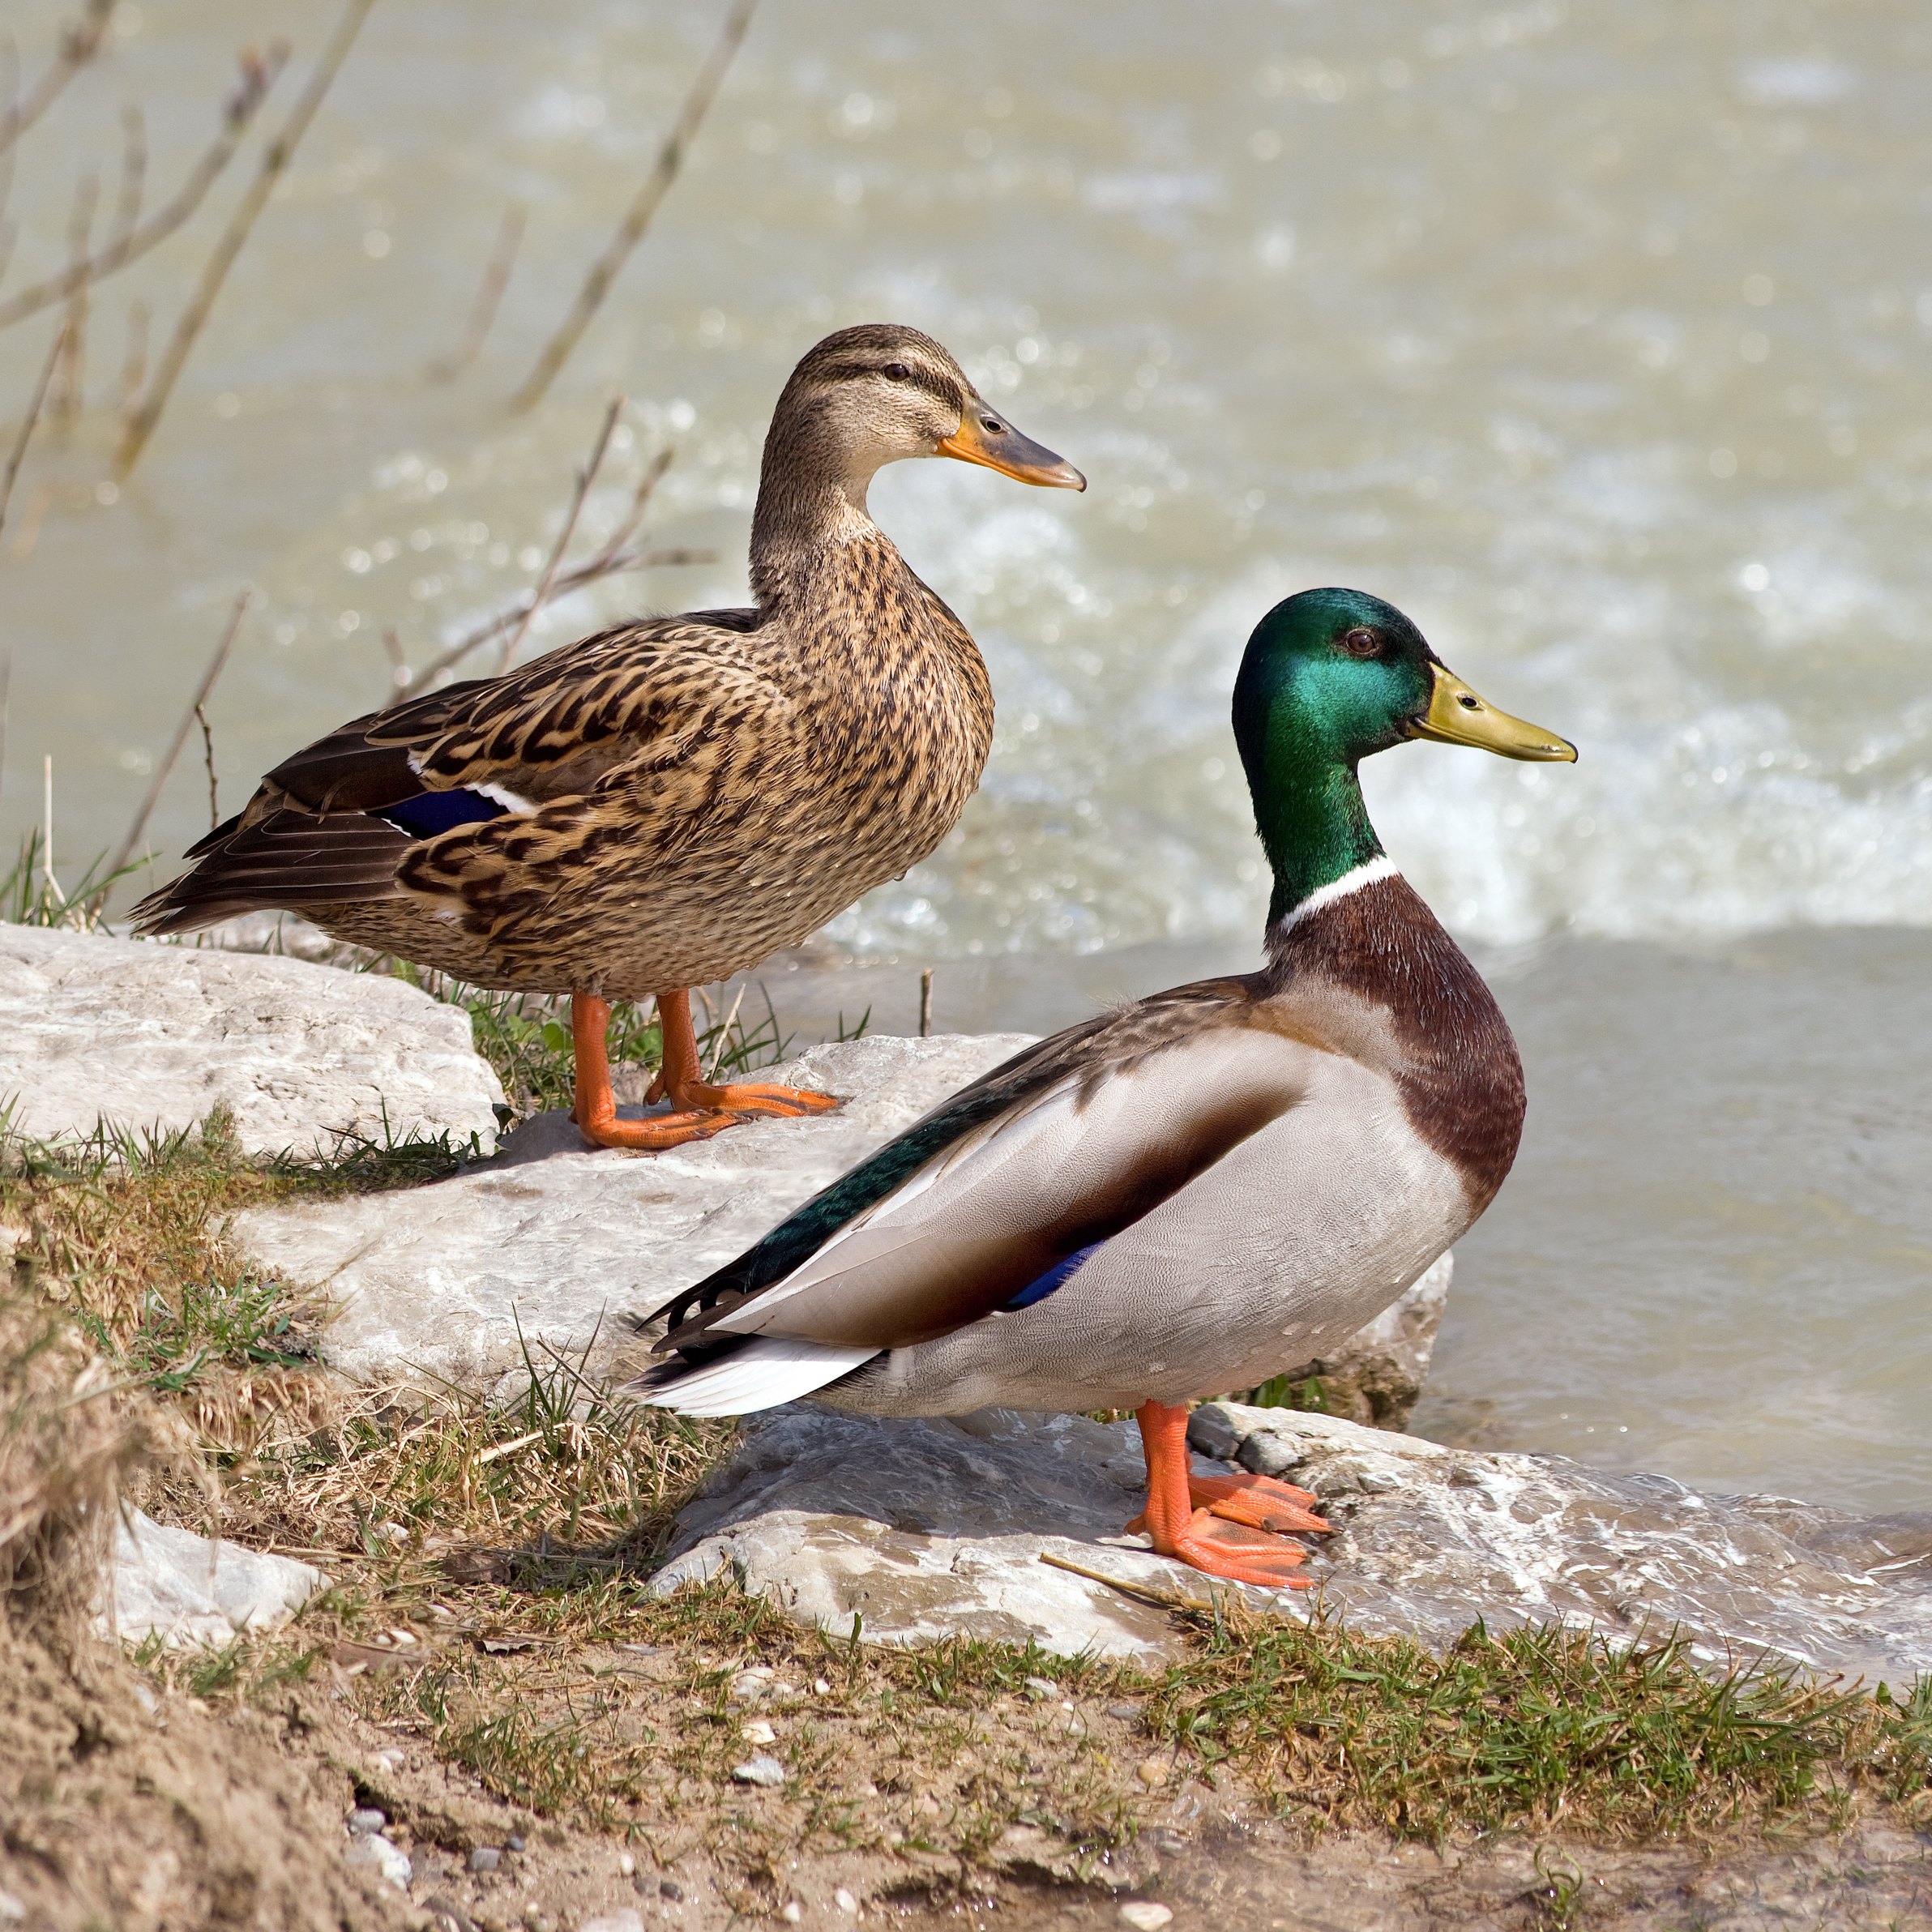

Slide 10
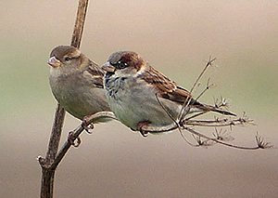

Slide 11
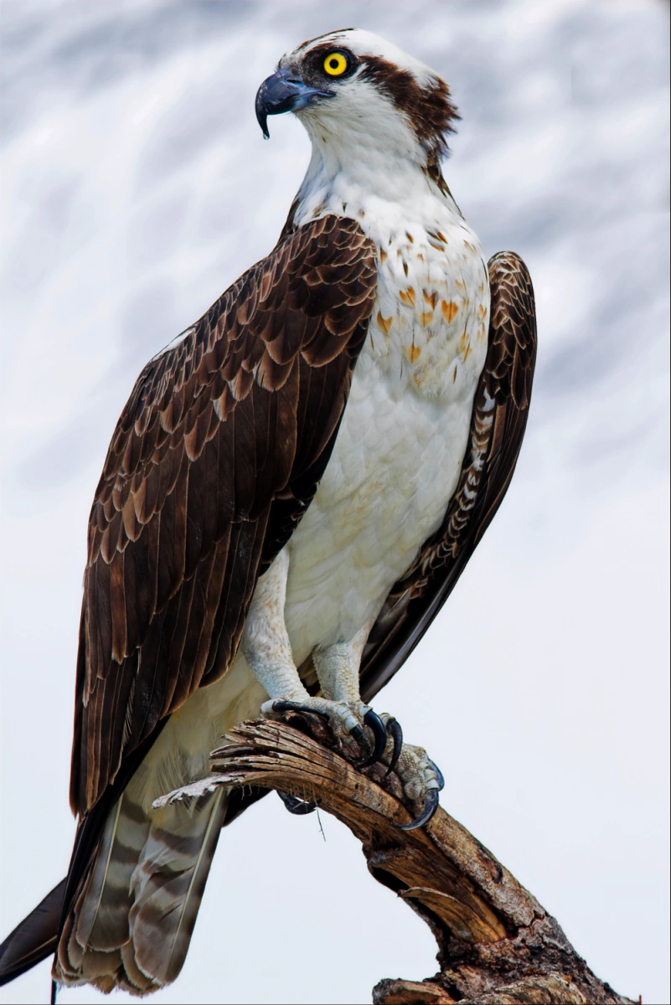

Slide 12
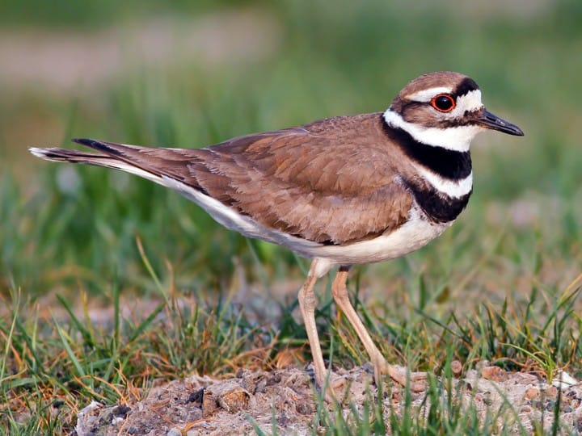

Slide 13
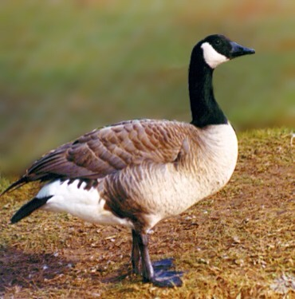

Slide 14
Answer key
1) title
2) Wood duck
3) European starling
4) great blue heron
5) bald eagle
6) brown-headed cowbird
7) belted kingfisher
8) red-winged blackbird
9) mallard duck
10) house sparrow
11) osprey
12) killdeer
13) Canada goose

